Slide 1
Other Taxes
Pub 4012 Tab H
Pub 17 Chapters 6, 10, 17, 30
(Federal 1040-Lines 57-63)
Notes:
1

Slide 2
Other Taxes
Includes:
Self-employment tax
Social Security/Medicare tax due on tips income
Additional tax on IRAs, other qualified retirement plans, etc.
Repayment of first-time homebuyer credit
Health care Individual responsibility payments (discussed in Affordable Care Act module)
Additional tax for HSA distributions not used for qualified medical expenses (HSA certification only)
Use Tax (NJ Only) – discussed in later module
Notes:
2

Slide 3
Self-Employment Tax
TaxSlayer enters automatically on Federal 1040 Line 57 from Schedule SE
TaxSlayer calculates amount using entries from Schedule C
Discussed as part of Business Income module
Notes:
3

Slide 4
Unreported Social Security & Medicare Tax
TaxSlayer enters automatically on Federal 1040 Line 58 from Form 4137 for tip income not reported on W-2 and allocated tips
Discussed as part of Employee Compensation module
Notes:
4

Slide 5
Additional Tax on IRAs & Other Qualified Retirement Plans
Includes:
10% penalty for early withdrawal from IRA or other qualified retirement plan before age 59½
50% penalty for failure to take full RMD
6% penalty for excess contributions to IRA - Out of Scope
TaxSlayer enters automatically on Federal 1040 Line 59 from Form 5329
Discussed as part of Retirement Income module
Notes:
5

Slide 6
Repayment of 2008 First-Time Homebuyer Credit
First-time homebuyers who took credit of up to $7,500 in 2008 must repay credit over 15 years
Repayments began in 2010
If taxpayer dies, repayment of credit is not required. However, if taxpayers filed a joint return and one of them dies, surviving spouse must still pay back his/her part
IRS no longer sends letter stating amount of credit, repayment amount
Link from TaxPrep4Free.org Preparer page to First Time Homebuyer Look-up Tool
Notes:
The repayment requirement relates to the 2008 First Time Home buyer credit & not the credits offered in other years (2009 & 2010)
6

Slide 7
Repayment of 2008 First-Time Homebuyer Credit
(cont’d)
Payment above minimum in any year does not change subsequent years’ minimum
It just pays off credit faster
Enter in Federal section \ Other Taxes \ First-time Homebuyer Repayment (Form 5405)
For MFJ clients, each must file individual Form 5405 listing ½ of required repayment amount
Refer to TaxPrep4Free.org Special Topics document for details
Notes:
7

Slide 8
Disposition of Home after Claiming 2008 Homebuyer Credit - Out of Scope
If home on which you received 2008 credit ceases to be main home, may have to repay remainder of loan (in full or in part) in that tax year
Home is sold, transferred in divorce, converted to rental/business property, converted to vacation or 2nd home, etc.
Form 5405 Part III must be completed
Out of scope
Notes:
8

Slide 9
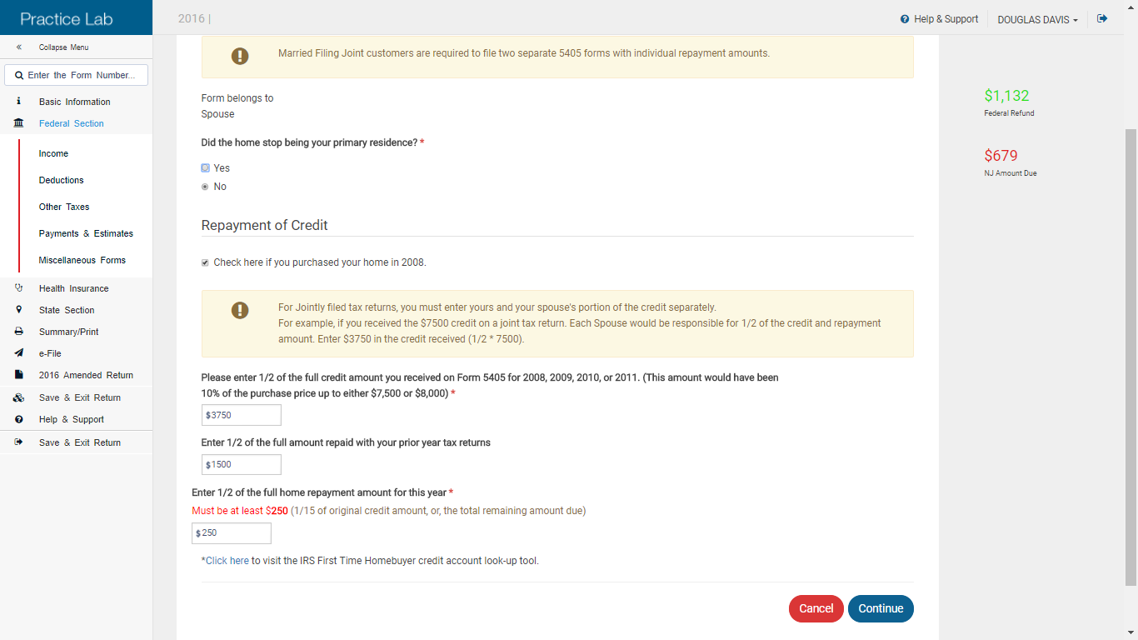
TS – Repayment of 2008 First-Time Homebuyer Credit Federal Section \ Other Taxes \ First-time Homebuyer Repayment (Form 5405)
MFJ couples must file separate Forms 5405
Credit received; ½ if MFJ
Amount already repaid; ½ if MFJ
Amount to be repaid this year; ½ if MFJ
Notes:
9

Slide 10
TS – Repayment of 2008 First-Time Homebuyer Credit – 1040 Line 60b
Repayment amount for 2008 First-Time
Homebuyer credit for both taxpayer and
spouse
Notes:
10

